Slide 1
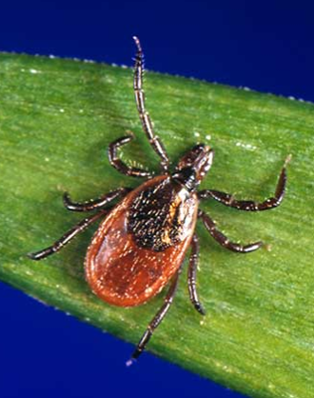

Tick borne illness yes, it really is a bad year
Meg Ryan, RN
Hawley Select Board August 12, 2025

Slide 2
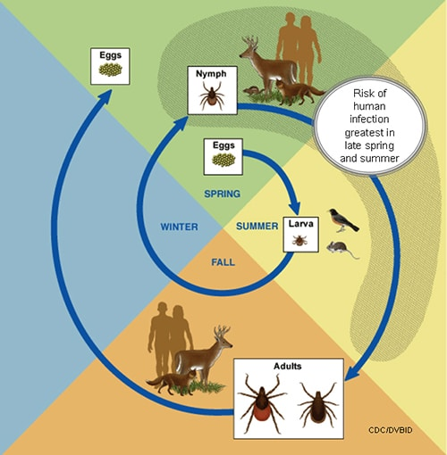
The Life Cycle of Ticks
Notes:
Active ALL YEAR. We get reports of tick borne illness every month of the year. Many factors affect how intense tick borne disease will be a given year – two year cycle including feeding on birds and mice or other rodents the summer of being a larva (first hatch), a meal from mammal blood while a nymph (spring and summer of second year) and another meal of mammal blood the year of being an adult, to allow for eggs to be created. SO the population of host animals and their food affect how many ticks there are as well as weather . Mast years for acorns mean well-fed mice and deer, so more opportunity for ticks to feed, so larva are well fed and more of them grow to nymphs etc. Cold weather means they are less active (but not completely unactive) and they like wet weather.
SEE JOHNS HOPKINS BOOKMARKED ARTICLE FOR MORE EXCELLENT INFO

Slide 3
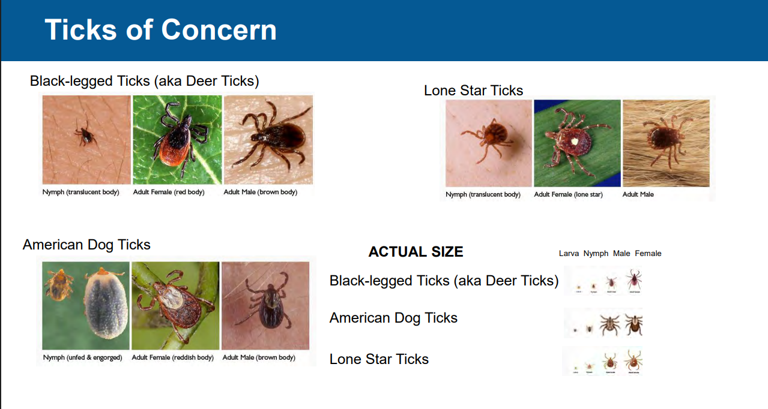

Slide 4
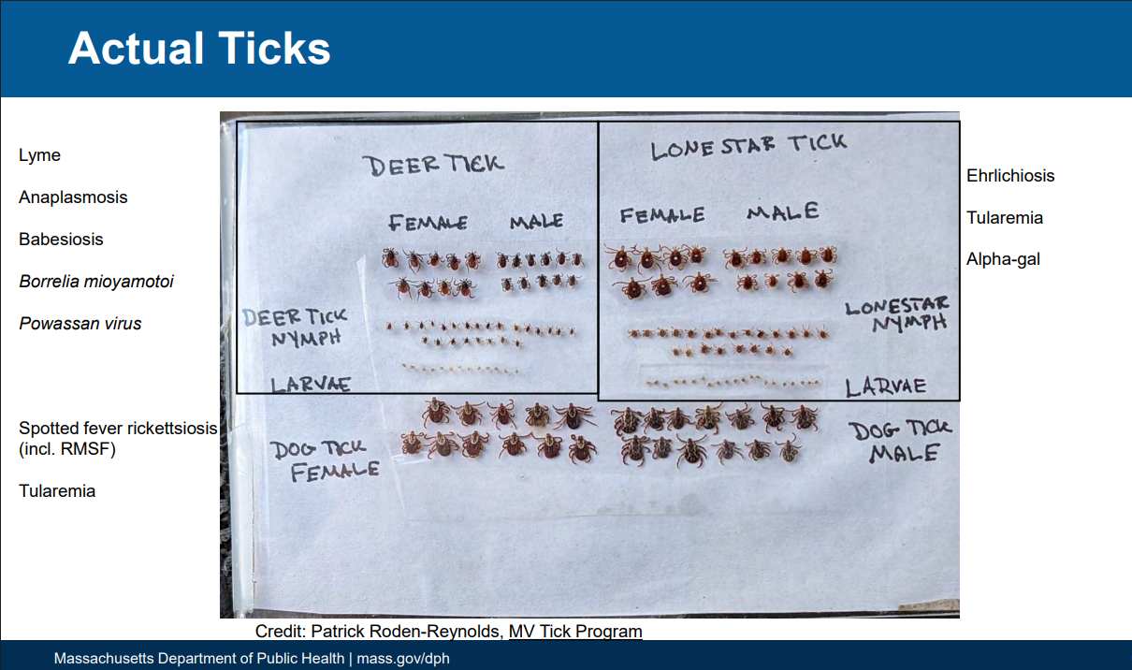

Slide 5
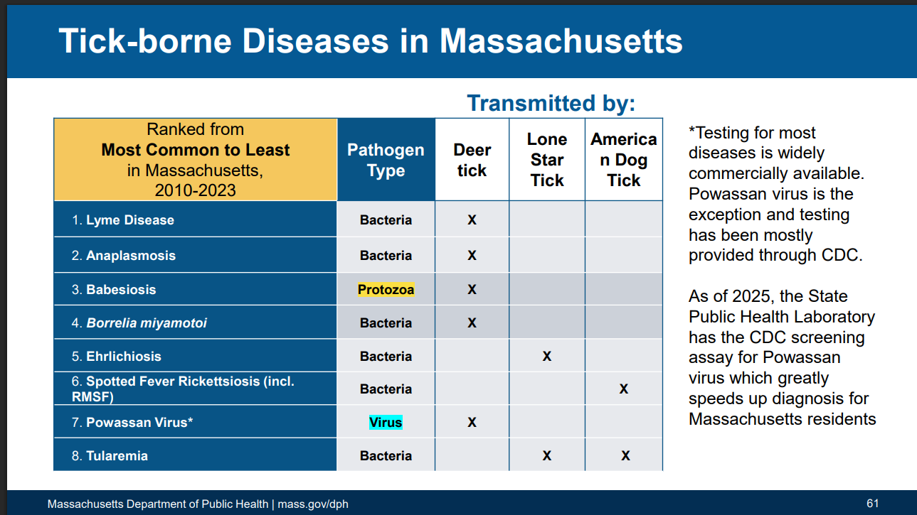
Tick borne illness: yes, it really is a bad year
Meg Ryan, RN
Oversight Board July 24, 2025
Notes:
From a DATE HERE presentation by Katie Brown on PHC
Lone Star tick can also expose people to the carbohydrate molecule Alpha-gal (GO TO NEXT SLIDE)

Slide 6
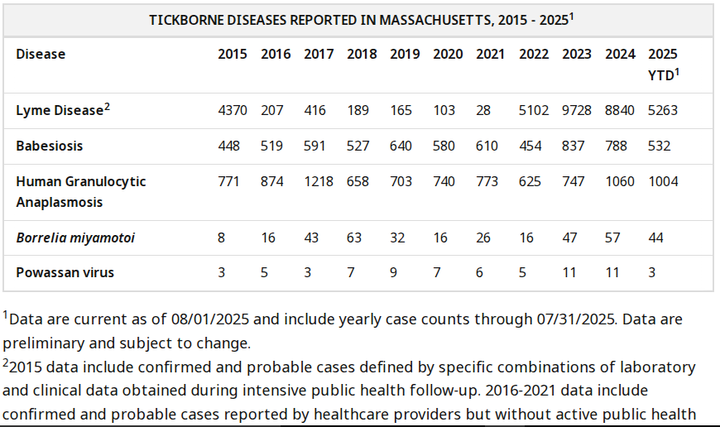
Tickborne Diseases Reported in Massachusetts, 2015-2025

Slide 7
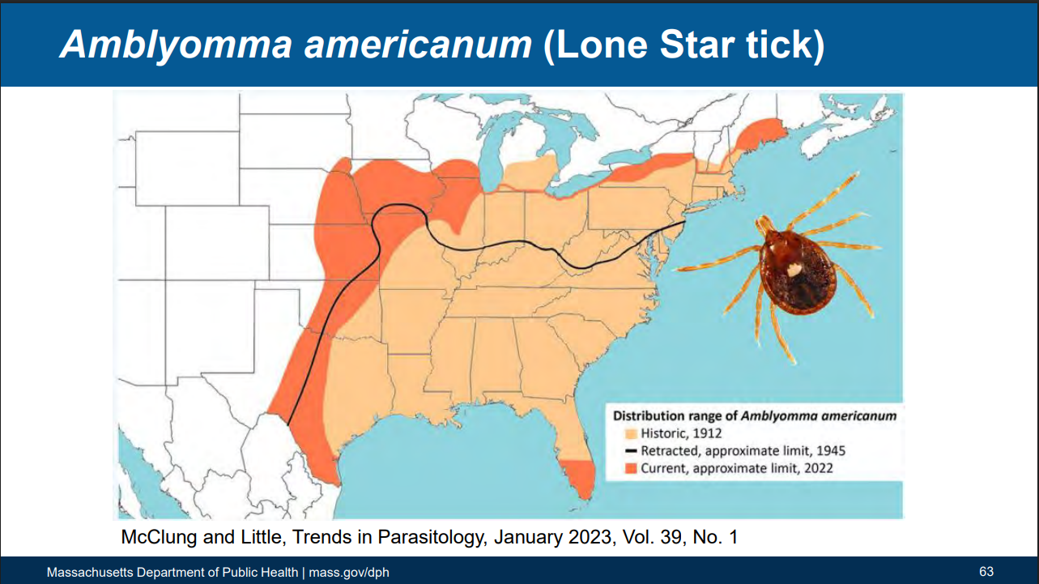

Slide 8
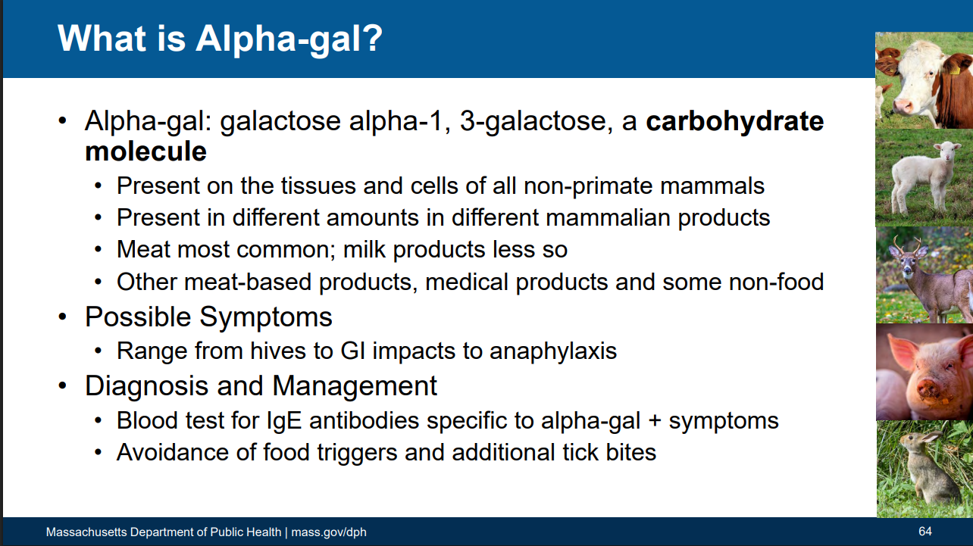
Notes:
From CDC: Alpha-gal syndrome (AGS) is a serious, potentially life-threatening allergy to alpha-gal that can develop after a tick bite.
Alpha-gal is a molecule found in most mammals, such as cows and pigs, but not in people.
People with AGS can have an allergic reaction after eating red meat or being exposed to products containing alpha-gal.
The best way to protect yourself and your family from AGS is to prevent tick bites.
Mostly from Lone star tick, but have been instances of black legged ticks bites causing it.

Slide 9
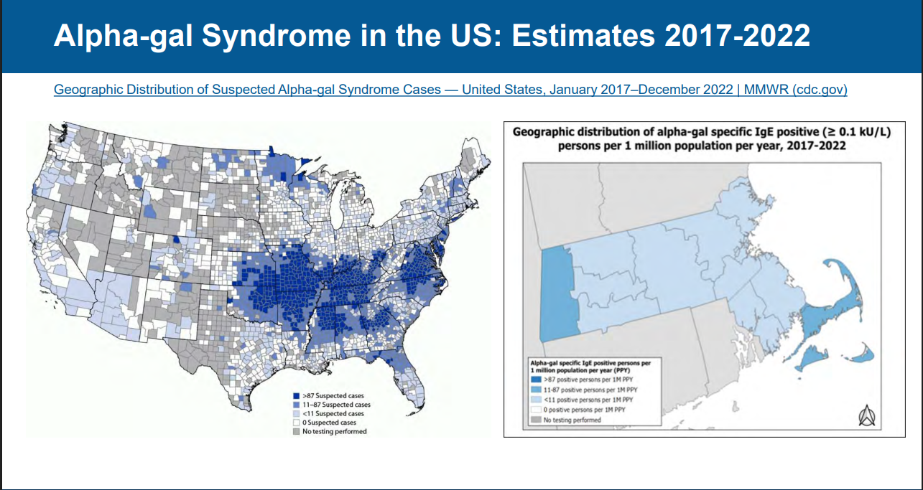

Slide 10
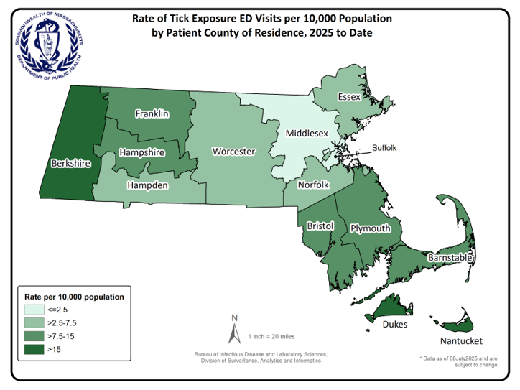
Rate of Tick Exposure ED visits
Notes:
State does a monthly report: This data is from the June 2025 report, the most recent available.
Tick Exposure and Tick-borne Disease Syndromic Surveillance Report, June 2025
Figure 2: This map shows the rate, per 10,000 total population, of ED visits by patients who had a visit related to a tick exposure, by Massachusetts county of residence, 2025 to date. Although there are differences in the rate of patient visits, this shows that people are exposed to ticks throughout all of Massachusetts and should take recommended steps to reduce the chance of being bitten.
Franklin County is 7.5 – 15 residents per 10,000.
Massachusetts Department of Public Health, Bureau of Infectious Disease and Laboratory Sciences. Tick Exposure and Tick-borne Disease Syndromic Surveillance Report, June 2025. http://www.mass.gov/eohhs/gov/departments/dph/programs/id/

Slide 11
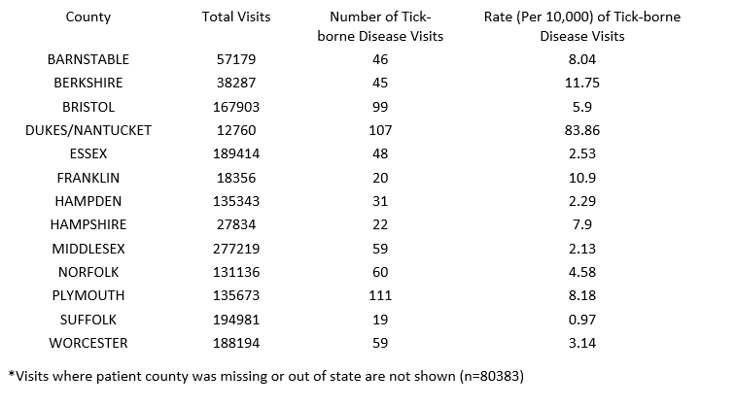
Number and Rate of Tick-borne disease visits
Notes:
Also from the June 2025
Tick Exposure and Tick-borne Disease Syndromic Surveillance Report, June 2025
Table 1: This table shows the number and the rate of ED visits by patients who were diagnosed with a tick-borne disease, by county 2025 to date.
Franklin County is one of only three counties in the double digits, at 10.9/10,000. Only Berkshire (just under 12) and Dukes/Nantucket is higher at almost 84 /10,000. Martha’s Vineyard is particularly hard hit. A recent article in

Slide 12
New England Tick Panel
3- 4 days turnaround serum test typically covering:
  Anaplasmosis
  Babesiosis
  Ehrlichiosis
  Lyme disease
Additionally, blood tests indicating RBC, WBC, Platelets, Liver Function may help diagnosis.
Treatment for Lyme and Analplasmosis is same (antibiotic typically Doxycycline), Babesiosis (parasite) typically treated with atovaquone plus azithromycin

Slide 13
Tickreport: tests ticks, not people
29C Cottage St.
Amherst, MA 01002
(413) 230-3196
Cost: $50-200/tick for species identification and testing for up to 23 different possible diseases carried by ticks. Results are available within 3 business days following receipt of tick. In addition, tick testing results, but not personal contact information, are shared through the Tick-Borne Disease Network Passive Surveillance Database to share information about where infected ticks are being found.

Slide 14
LBOH role: Infectious Disease Monitoring
MAVEN reports are received for Tick-borne Illness
  Lyme Disease acknowledgement only
  Anaplasmosis and Babesiosis, other less common are investigated and a Case Report Form is submitted
  Share out of resources tick-borne disease prevention, “Tick Lab” display, Support local permethrin spray events.

Slide 15
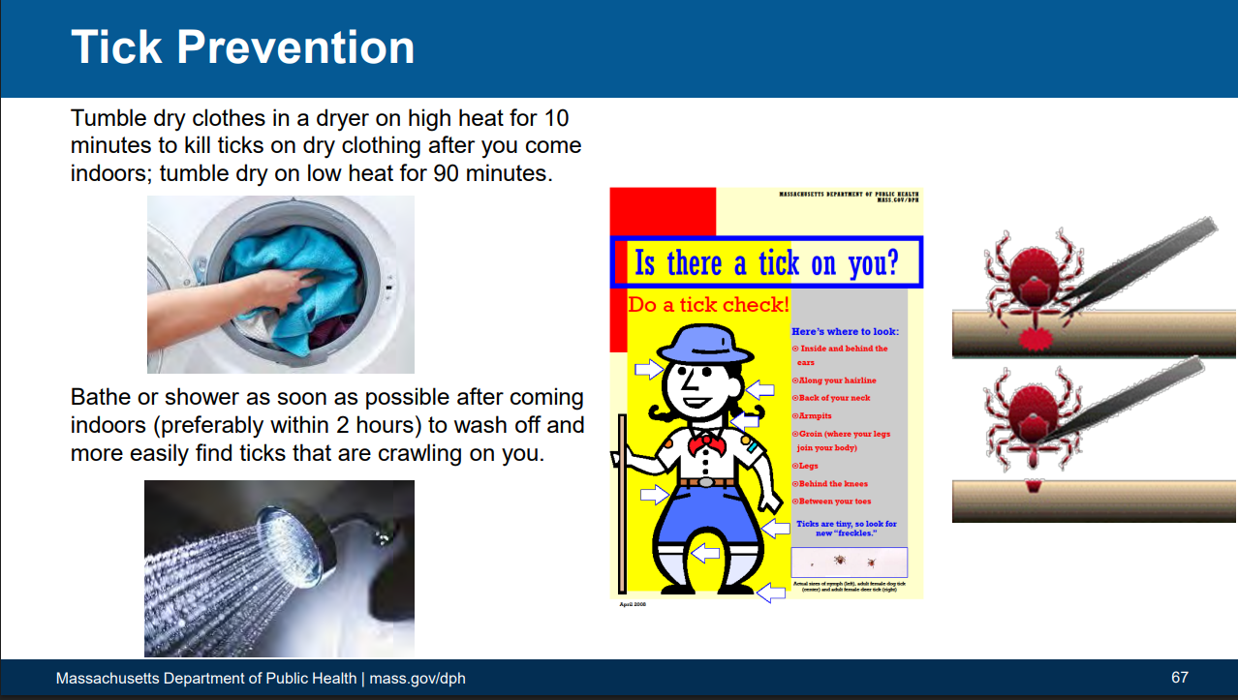
Notes:
Info about repellants
https://www.healthychildren.org/English/safety-prevention/at-play/pages/Insect-Repellents.aspx from the American academy of pediatrics
To prevent tick bites:
use insect repellents that contain an EPA-registered active ingredient like permethrin or DEET,
wear light-colored clothing to more easily spot ticks,
do daily tick checks, and
promptly and properly removing any attached ticks.

